Slide 1
Xtext Workshop
Thomas Fischl

Slide 2
Agenda
Xtext Overview
Grammar
Validator
Code Generator
Quick Fix
Unit Test
4 Exercises

Slide 3
What is Xtext?
Xtext is a framework for development of programming languages and domain specific languages. (Eclipse Xtext Website)
Eclipse Toplevel Project
Open Source Project
Highly Configurable Framework

Slide 4
What is a DSL?
A Domain-Specific Language (DSL) is a small programming language, which focuses on a particular domain. (Eclipse Xtext Website)

Slide 5


Who is behind Xtext?
itemis AG
Hauptsitz: Lünen, Deutschland
Consulting, Training
Sven Efftinge

Slide 6
xText Building Blocks
ANTLR
ECore Framework
OSGi
SWT
Google Guice
Xtend

Slide 7
What do you get from Xtext?
Compiler (Lexer, Parser, Reconciler)
AST (Ecore Model)
Serializer
Code Generator Environment
Eclipse Editor
Syntax Coloring
Content Assist
Validation and Quick Fixes
Refactoring

Slide 8
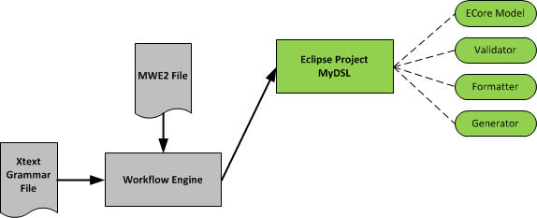
Xtext Workflow
Notes:
MWE2 => Modeling Workflow Engine 2

Slide 9
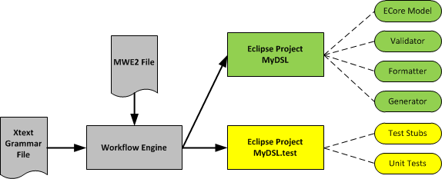
Xtext Workflow

Slide 10
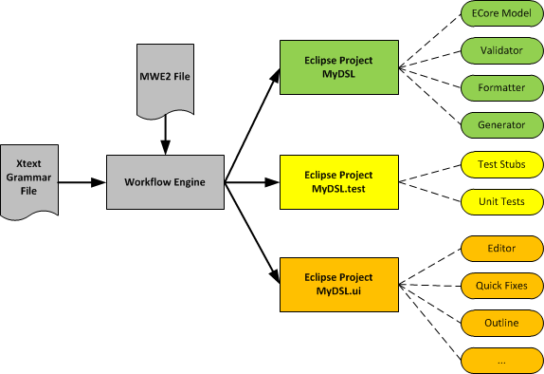
Xtext Workflow

Slide 11
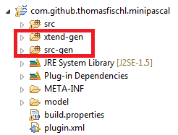
Never change generated code!

Slide 12
Xtext: Grammar

Slide 13
Example - EBNF
Model =
{Greeting} .
Greeting =
"Hello" ID "!" .
ID =
('a'..'z'|'A'..'Z'|'_') {'a'..'z'|'A'..'Z'|'_'|'0'..'9'} .

Slide 14
Example - Xtext Grammar
grammar org.xtext.example.mydsl.MyDsl // language name
with org.eclipse.xtext.common.Terminals // include predefined terminal rules
hidden (ML_COMMENT) // define comment style
generate myDsl // generate an ecore model for this grammar
"http://www.xtext.org/example/mydsl/MyDsl"
Model: // parser rule
greetings+=Greeting /*NTS*/ *;
Greeting: // parser rule
'Hello' /*TS*/ name=ID/*TS*/ '!';
terminal ID: // terminal rule
('a'..'z'|'A'..'Z'|'_') ('a'..'z'|'A'..'Z'|'_'|'0'..'9')*;
terminal ML_COMMENT: // terminal rule
'/*'->'*/';

Slide 15
Xtext Grammar: Parser Rule
VarDecl:
"VAR" vars+=
VarName ("," vars+=VarName)*
":" "INTEGER" ";" ;
Hint: Each parser rule is converted into an ECore class.

Slide 16
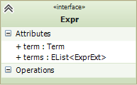
Xtext Grammar: Assignments
Expr:
term=Term (terms+=ExprExt)*;

Slide 17
Xtext Grammar: Terminal String
VarDecl:
"VAR" vars+=
VarName ("," vars+=VarName)*
":" "INTEGER" ";";

Slide 18
Xtext Grammar: Alternatives
Fact:
var=IDENT |
number=NUMBER |
"(" expr=Expr ")";

Slide 19
Xtext Grammar: Repetition
Expr:
term=Term (terms+=ExprExt)*;

Slide 20
Xtext Grammar: Grouping
Expr:
term=Term (terms+=ExprExt)*;

Slide 21
Xtext Grammar: Cross Reference
Transition :
event=[Event] '=>' state=[State];
Event: ....;

Slide 22
Xtext Grammar: Terminal Rule
terminal ID :
('a'..'z'|'A'..'Z'|'_') ('a'..'z'|'A'..'Z'|'_'|'0'..'9')*;

Slide 23
Xtext Grammar: Terminal Rule
terminal NUMBER returns ecore::EInt:
('0'..'9')+;

Slide 24
Demo Project: Mini Pascal

Slide 25
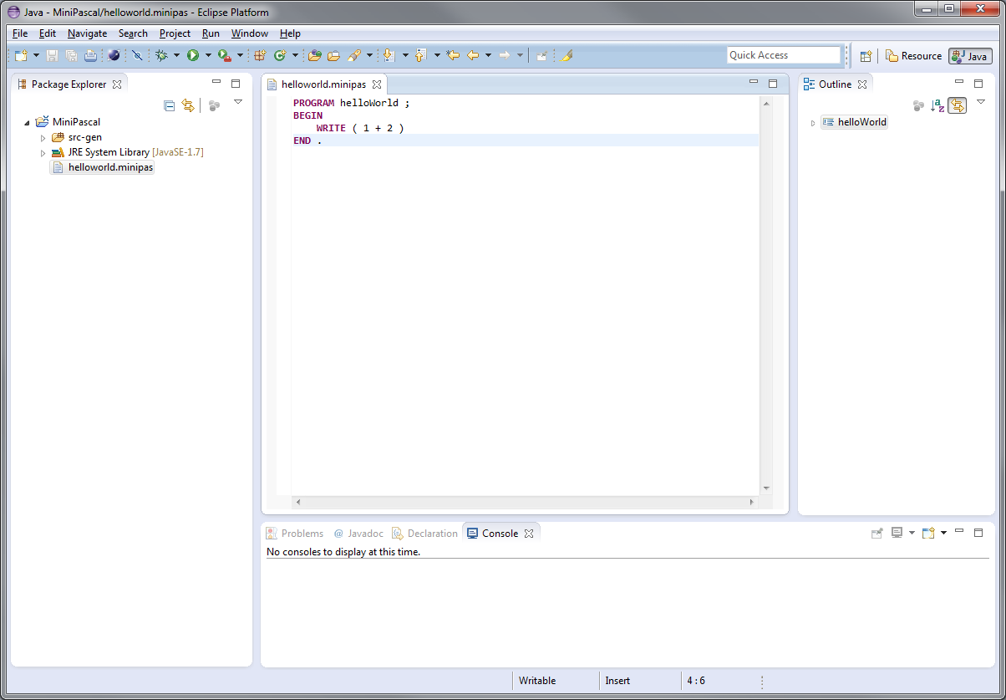
Editor

Slide 26
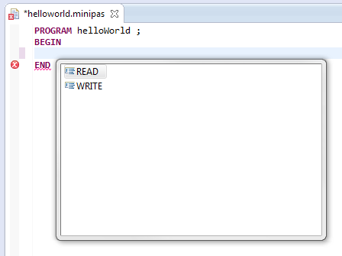
Content Assist

Slide 27
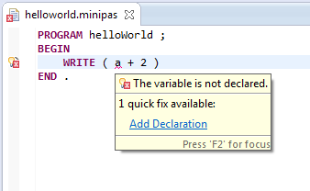
Validator & Quick Fix

Slide 28
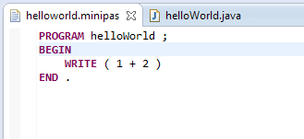
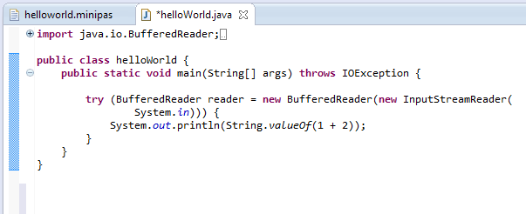
Code Generator

Slide 29
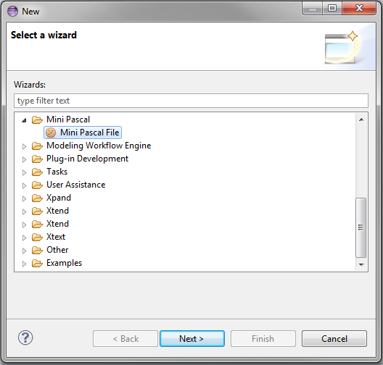
New File Wizard

Slide 30
Exercise 1
Mini Pascal Xtext Grammar

Slide 31
Mini Pascal Grammar – EBNF
MP = "PROGRAM" ident ";"
[ VarDecl ]
"BEGIN" StatSeq "END" "." .
VarDecl = "VAR" ident { "," ident } ":" "INTEGER" ";” .
StatSeq = Stat { ";" Stat } .
Stat = [ ident ":=" Expr
| "READ" "(" ident ")"
| "WRITE" "(" Expr ")"
] .
Expr = Term { ( "+" | "-" ) Term } .
Term = Fact { ( "*" | "/" ) Fact } .
Fact = ident | number | "(" Expr ")" .

Slide 32
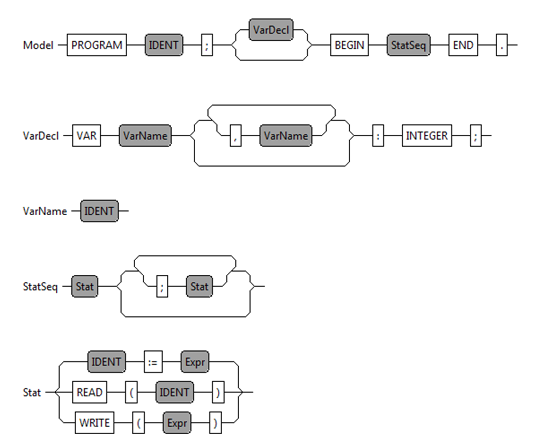
Mini Pascal - Syntax Diagram

Slide 33
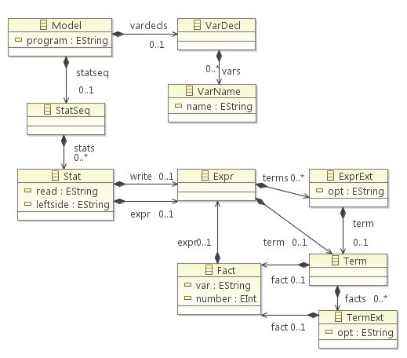
Mini Pascal – ECore Diagram

Slide 34
Mini Pascal Grammar – Xtext (1)
Model:
"PROGRAM" program=IDENT ";"
(vardecls=VarDecl)?
"BEGIN"
statseq=StatSeq
"END" ".";
VarDecl:
"VAR" vars+=VarName ("," vars+=VarName)* ":" "INTEGER" ";" ;
VarName:
name=IDENT ;

Slide 35
Mini Pascal Grammar – Xtext (2)
StatSeq:
stats+=Stat (";" stats+=Stat)* ;
Stat:
leftside=IDENT ":=" expr=Expr
| "READ" "(" read=IDENT ")"
| "WRITE" "(" write=Expr ")" ;

Slide 36
Exercise: Description
Download the grammar artefact and copy it into the Pascal.xtext file
http://goo.gl/7uPtOx
Complete the grammar
Generate all artefacts
Run Eclipse with Plugin

Slide 37
Mini Pascal Grammar – Xtext (3)
http://goo.gl/7rNPLB
Expr:
term=Term (terms+=ExprExt)*;
ExprExt:
(opt="+" | opt="-") term=Term ;
Term:
fact=Fact (facts+=TermExt)*;
TermExt:
(opt="*" | opt="/") fact=Fact ;
Fact:
var=IDENT | number=NUMBER | "(" expr=Expr ")";

Slide 38
Xtext: Validation Framework

Slide 39
Xtext Validation Framework
Automatic Validation
Syntactical Validation
Cross-link Validation
Custom Validation
Extends AbstractPascalJavaValidator
Implement @Check methods

Slide 40
Xtext Validation API
Add Information:
protected void info(String message, EStructuralFeature feature , int index)
Add Warning:
protected void warning(String message, EStructuralFeature feature, int index)
Add Error:
protected void error(String message, EStructuralFeature feature, int index)

Slide 41
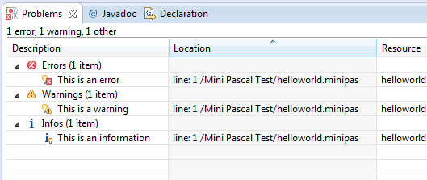
Xtext Validation API

Slide 42
Custom Validation API
public class PascalJavaValidator extends AbstractPascalJavaValidator {
@Check
public void checkVariableName(Fact fact) {
// Validation Implementation
}
}

Slide 43
Exercise 2
Double Variable Declaration Validator

Slide 44
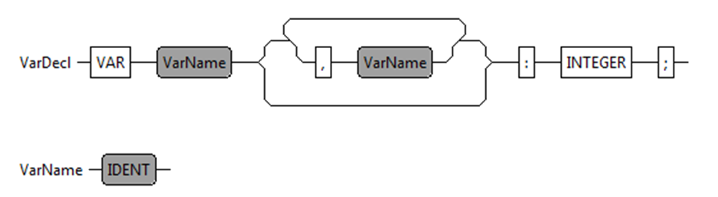
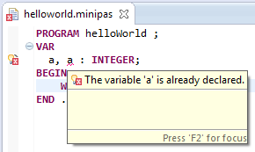
Double Variable Declaration Check

Slide 45
Exercise: Description
Download the validation artefact and copy it into the PascalJavaValidator Java file
http://goo.gl/JpFXnv
Complete the validator
Run the eclipse plugin

Slide 46
Double Variable Declaration Check
@Check
public void checkDoubleVariableDeclaration(VarDecl varDecl) {
Set<String> varNames = new HashSet<String>();
for (VarName var : varDecl.getVars()) {
if (varNames.contains(var.getName())) {
String msg = String.format("The variable '%s' is already
declared.", var.getName());
error(msg, var, PascalPackage.Literals.VAR_NAME__NAME,
REMOVE_VARIABLE, var.getName());
} else {
varNames.add(var.getName());
}
}
}
http://goo.gl/eVMfmV

Slide 47
Xtext: Code Generator Framework

Slide 48
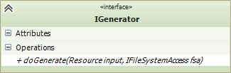
Xtext Code Generator Framework
Implement IGenerator interface
Java
Xtend

Slide 49
Xtext Code Generator Framework
Bind IGenerator implemenation in the RuntimeModel class
public abstract class AbstractPascalRuntimeModule extends DefaultRuntimeModule {
public Class<? extends IGenerator> bindIGenerator() {
return PascalGenerator.class;
}
}

Slide 50
Generator Implemenation (Xtend)
class PascalGenerator implements IGenerator {
override void doGenerate(Resource resource, IFileSystemAccess fsa) {
for (e : resource.allContents.toIterable.filter(Model)) {
fsa.generateFile(e.program + ".java", e.compile)
}
}
def CharSequence compile(Model model) '''
Implemenation
'''
}

Slide 51
Exercise 3
Expression Code Generator

Slide 52
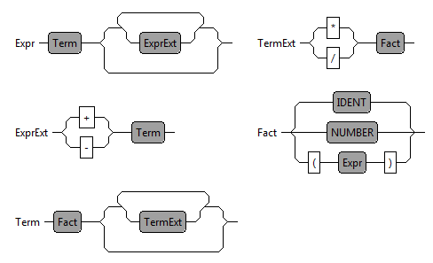
Expression Code Generator

Slide 53
Exercise: Description
Download the generator artefact and copy it into the PascalGenerator Xtend file
http://goo.gl/Vm5QWk
Complete the generator
Run the eclipse plugin

Slide 54
Xtext: Quick Fix

Slide 55
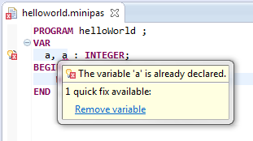
A Quick Fix …
helps the developer to improve his performance! (STRG+ 1)
is connect with a validator message.
can modify the model or the text representation.

Slide 56
Validator Implementation
@Check
public void checkDoubleVariableDeclaration(VarDecl varDecl) {
Set<String> varNames = new HashSet<String>();
for (VarName var : varDecl.getVars()) {
if (varNames.contains(var.getName())) {
String msg = String.format("The variable '%s' is already
declared.", var.getName());
error(msg, var, PascalPackage.Literals.VAR_NAME__NAME,
REMOVE_VARIABLE, var.getName());
} else {
varNames.add(var.getName());
}
}
}

Slide 57
Quick Fix Implementation
@Fix(PascalJavaValidator.REMOVE_VARIABLE)
public void fixUnusedVariable(final Issue issue, IssueResolutionAcceptor acceptor) {
String msg = String.format("Remove unused variable '%s'.", issue.getData()[0]);
acceptor.accept(issue, "Remove variable", msg, "upcase.png", new ISemanticModification() {
@Override
public void apply(EObject element, IModificationContext context) {
if (element instanceof VarName) {
VarDecl parent = (VarDecl) element.eContainer();
parent.getVars().remove(element);
if (parent.getVars().isEmpty()) {
ModelImpl model = (ModelImpl) parent.eContainer();
model.setVardecls(null);
}
}
}
});
}

Slide 58
Xtext: Formatter

Slide 59
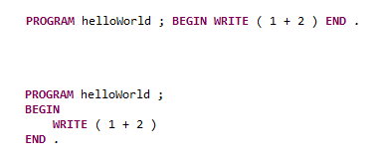
Xtext Formatter
The Formatter is a pretty print function for the DSL. (STRG + SHIFT + F)

Slide 60
Formatter Implemenation
@Override
protected void configureFormatting(FormattingConfig c) {
c.setAutoLinewrap(120);
c.setLinewrap().before(grammarAccess.getModelAccess().getBEGINKeyword_4());
c.setLinewrap().after(grammarAccess.getModelAccess().getBEGINKeyword_4());
c.setLinewrap().before(grammarAccess.getModelAccess().getENDKeyword_6());
c.setLinewrap().before(grammarAccess.getVarDeclRule());
c.setLinewrap().after(grammarAccess.getVarDeclRule());
c.setLinewrap().after(grammarAccess.getVarDeclAccess().getVARKeyword_0());
}
}

Slide 61
Xtext: Unit Test

Slide 62
Unit Test for the Xtend Generator
@RunWith(XtextRunner.class)
@InjectWith(PascalInjectorProvider.class)
public class PascalGeneratorTest {
@Inject
IGenerator generator;
@Inject
ParseHelper<Model> parser;
// TODO Unit Test
}

Slide 63
Unit Test for the Xtend Generator
@Test
public void testHelloWorld() throws Exception {
testMiniPasFile("helloworld");
}
private void testMiniPasFile(String name) throws Exception {
Model model = parser.parse(readFile(name + ".minipas"));
assertNotNull(model);
InMemoryFileSystemAccess fsa = new InMemoryFileSystemAccess();
generator.doGenerate(model.eResource(), fsa);
assertEquals(1, fsa.getTextFiles().size());
String result = fsa.getTextFiles().values().iterator().next().toString();
assertEquals(readFile(name + ".output"), result);
}

Slide 64
Xtext: ByteCode Generator

Slide 65
Summary
Textual DSL Framework
Highly configurable and flexible framework
Easy code generator implemenation
Demo Project:
https://github.com/thomasfischl/xtext-workshop

Slide 66


Books
http://www.amazon.de/Domain-Specific-Languages-Addison-Wesley-Signature
http://www.amazon.de/DSL-Engineering-Designing-Implementing-Domain-Specific

Slide 67
More Infos
ANTLR http://www.antlr.org/
Xtext http://www.eclipse.org/Xtext/
Xtend http://xtend-lang.org
Google Guice: https://code.google.com/p/google-guice/
EMF: http://www.eclipse.org/modeling/emf/

